Slide 1
Upward Muon Search Experiment
By: Sri Gaddam and Serena Garza
Final Presentation
3 August 2022

Slide 2
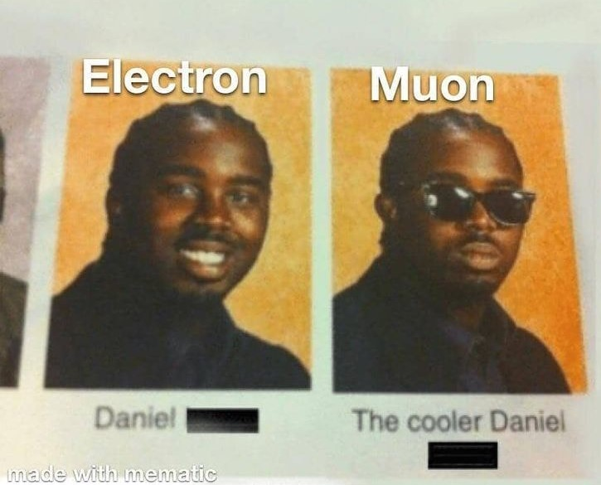
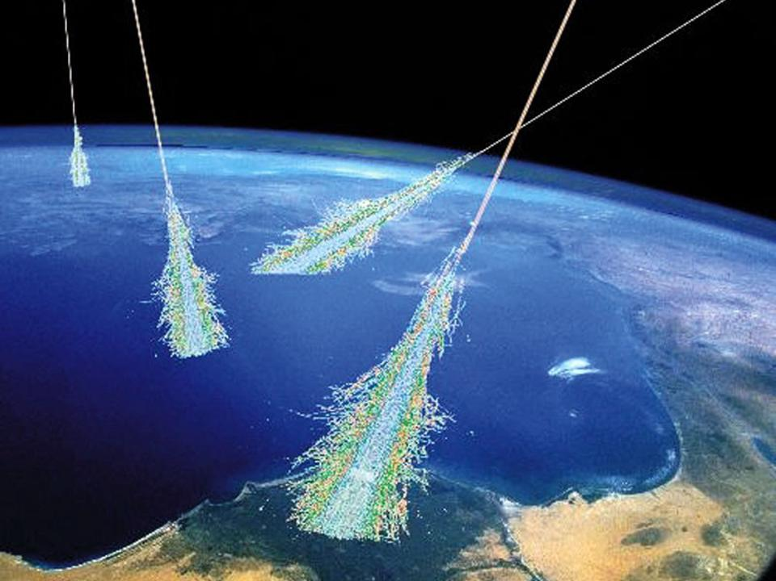
Background
What are muons?
Particles in the same grouping as electrons (leptons), but with a greater mass. Formed when cosmic rays in Earth's atmosphere interact with other particles.
What are muon showers?
Come from cosmic rays, multiple muons
What is the goal of our project?
Are there any muons that go up?

Slide 3
Idea
The idea of this project is to analyze muon shower data to be able to determine which muons in the shower are actually traveling upward
To do this, we created plots to graph the data. With the plots we will zoom in on the ends (or tails) of the plots
The tail will show us the signal region and if there are any “bumps” or data points that seem like outliers, this is where the upward muon is likely to be
With the plots that we create, we want to be able to analyze more specific data points without changing the resolution of the plot

Slide 4
Our Team
We worked with a few other people to help us bring our idea to life:
Professor Mark Adams: Mentor; guided us through the whole experiment with his expertise on cosmic rays
Edit Peronja: assisted with coding and debugging the code
Adam LaMee: shared his code which helped to start off the creation of our tool and analyzation of our data

Slide 5
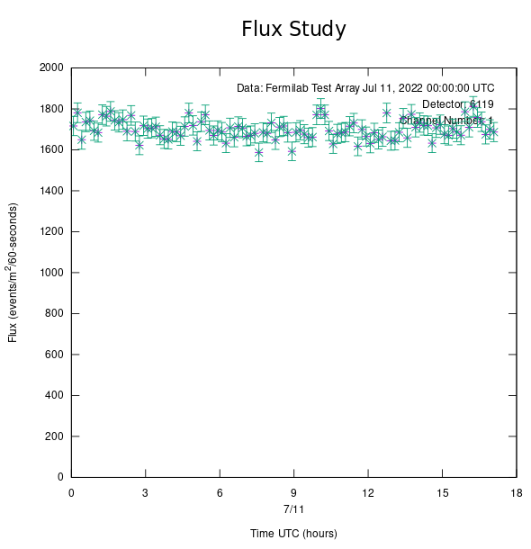
E-Lab
The QuarkNet Cosmic Ray e-Lab contains data sets regarding cosmic ray events.
Tool that helps teachers perform experiments.
Has features to analyze muon events.
- Flux
- Shower
- Lifetime
- Time of Flight

Slide 6
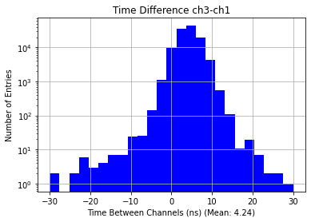
Motivation
New calculation/visualization tool
- New analysis method
- Improves existing QuarkNet system
- Identify upward muon candidates
- Implement new Hybrid File
- Output corrected for pulse width distribution

Slide 7
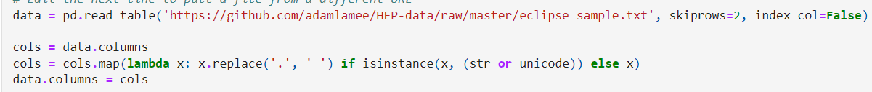
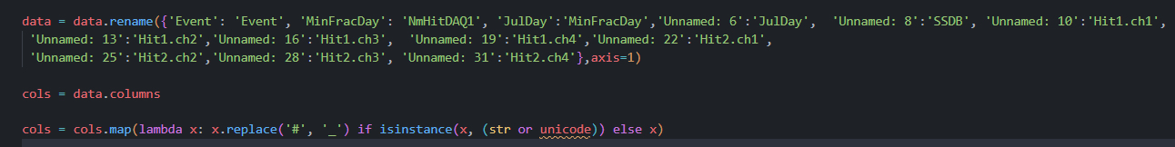
Hybrid File Format
Existing
Future

Slide 8
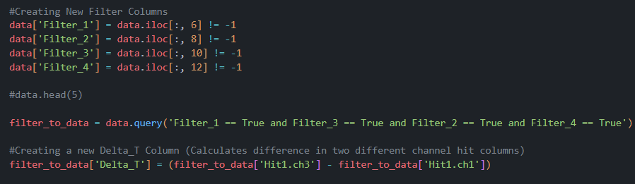
Filter Data
- Recording values that were -1
- Messes up calculations between counters
- Plots incorrect/unusable graphs

Slide 9
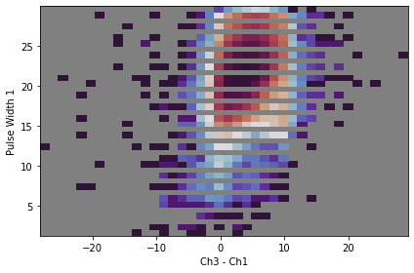
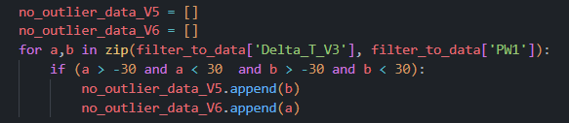
Pulse Width Distribution
Big pulses fire earlier than small pulses
Muon signal takes time to get large
Weak variation of pulse
Correction of pulse width

Slide 10
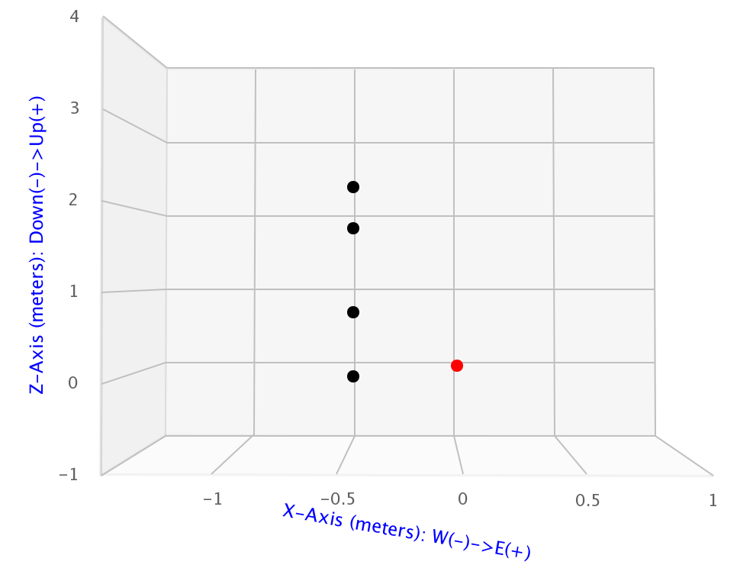
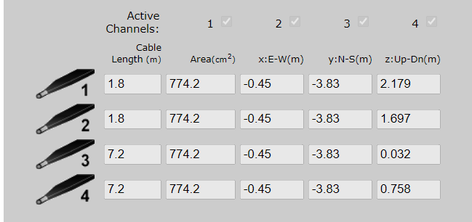
Geometry
1
2
4
3

Slide 11
Calculation of Limit/Signal Region
Ch1: 2.179 (m)
Ch2: 1.697 (m)
Ch3: 0.032 (m)
Ch4: 0.758 (m)
Speed of Light
Distance
Speed of Light
1.697 (m) - 0.032 (m) = 1.67 (m)
1.67 (m) / c = 5.6 (ns)
Mean
Sigma
Limit Calculation
-8.34 (ns) + (2 * 2.4 (ns)) = -3.54 (ns) (Limit 1)
-8.34 (ns) - (2 * 2.4 (ns)) = -13.14 (ns) (Limit 2)
2.86 (ns) - 11.2 (ns) = -8.34 (ns)

Slide 12
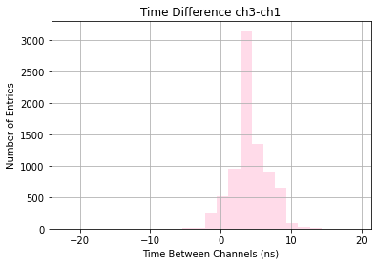
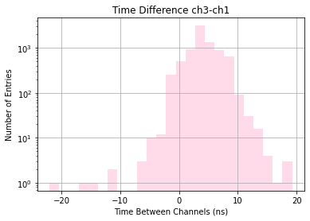
Linear vs Log Plots: ch3-ch1
Signal Region: Between -15.2 (ns) and -5.2 (ns)
Signal Events: 6
Ratio: 6/8,000 = 0.07%

Slide 13
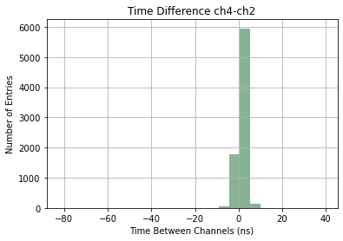
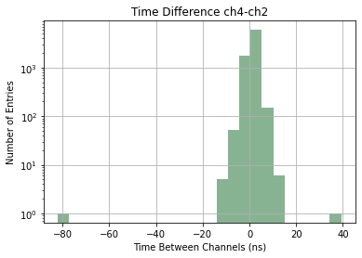
Linear vs Log Plots: ch4-ch2
Signal Region: Between -8.9 (ns) and -1.7 (ns)
Signal Events: 554
Ratio: 554/8,000 = 6.9%

Slide 14
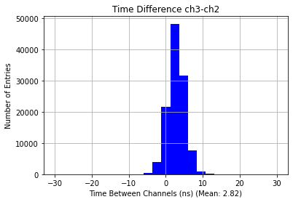
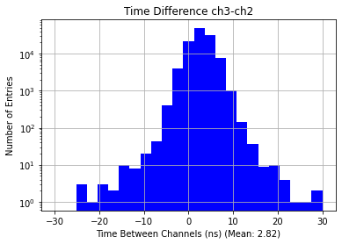
Linear vs Log Plots: ch3-ch2
Signal Region: Between -3.54 (ns) and -13.14 (ns)
Signal Events: 471
Ratio: 471/114,000 = 0.41%

Slide 15
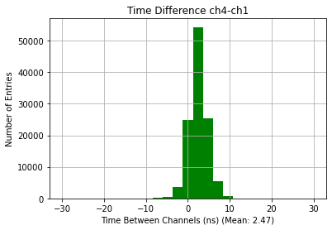
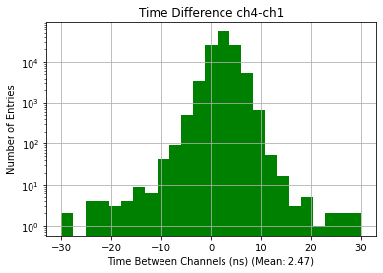
Linear vs Log Plots: ch4-ch1
Signal Region: Between -11.45 (ns) and -2.6 (ns)
Signal Events: 1524
Ratio: 1524/114,000 = 1.3%

Slide 16
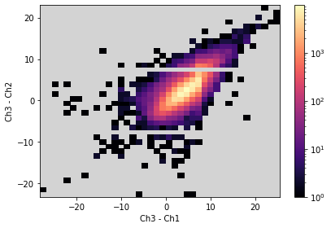
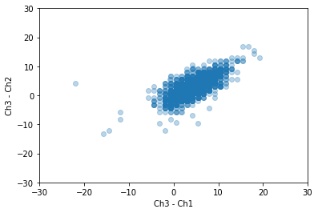
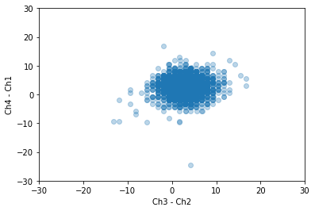
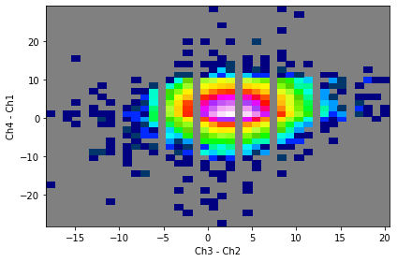
2D Imaging of Plots
10,000
1

Slide 17
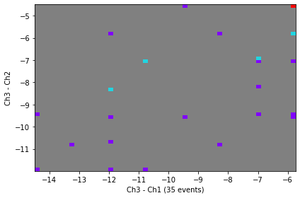
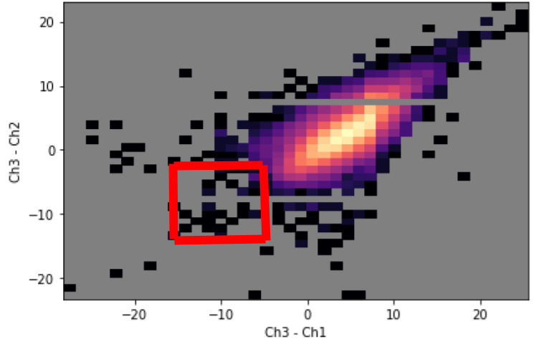
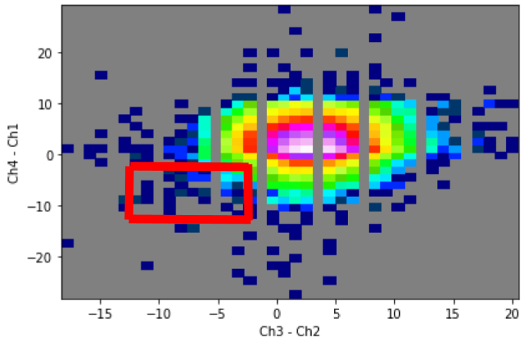
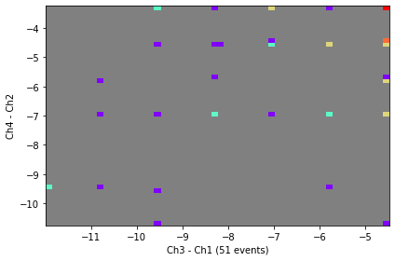
Signal Region Visualization
Upward Muon Signal Region

Slide 18
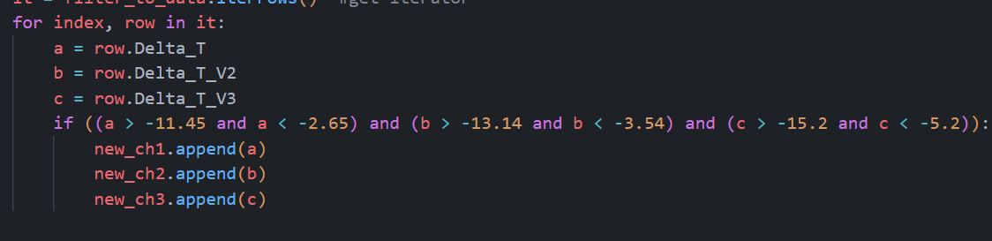
3D Channel Comparison
One Sigma Cut
Channel 3 v Channel 1
-12.7 < x < -7.7
Channel 3 v Channel 2
-10.8 < x < -6.0
Channel 4 v Channel 1
-9.3 < x < -4.9
3 Potential Candidates
Two Sigma Cut
Channel 3 v Channel 1
-15.2 < x < -5.2
Channel 3 v Channel 2
-13.14 < x < -3.54
Channel 4 v Channel 1
-11.45 < x < -2.6
27 Potential Candidates

Slide 19
In the Future…
We’d love to take a deeper look into the effect that the pulse width measurement has on the data
We did not have access to a detector, so we would like to be able to set up a detector and collect our own data
Increase the vertical separation
We built this tool for the future
Accessible to everyone

